Slide 1
Building Market Linkages for smallholder Farmers in Uganda

Slide 2
Strong Integration of Commodity Value Chains
Some expensive investments used to achieve this:
  Infrastructure investments including;
    Road networks
    Storage capacity development
Information Technology provides a more cost-effective alternative, but:
  Provision of price information to farmers often is not sufficient
  A fundamental shift in intermediary power structure of actors is necessary (farmers able to negotiate as value chain shareholders

Slide 3
Changing intermediary market power structure to improve farm-gate prices
Farmers being organized and empowered to make business decisions
Ready access to critical investment financing necessary (Matching Grants)
Access to relevant market information in real time for decision making
Building Productive Alliances (Cutting out multiple intermediaries to bring efficiencies)
Investments in infrastructure to improve access and necessary storage capacity)

Slide 4
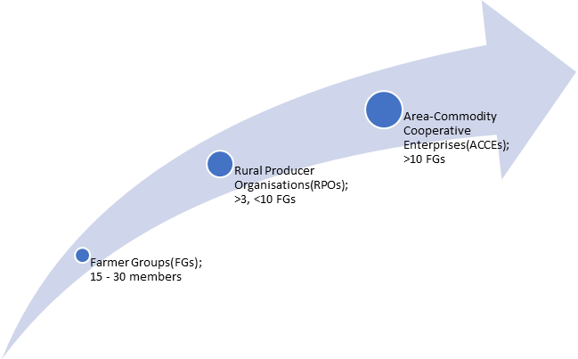
Strengthening the institutional and agribusiness capacities of Farmer Organizations
ACCEs:
Value addition & Product development (Matching grants)
Market Access infrastructure (ICT & Roads)
Capacity building to network and serve members
Rural Producer Groups:
Output bulking and access to markets
Post-harvest handling investments
Removal of road chokes
Farmer Groups:
Formation, strengthening & Transformation
Support Productivity & production through e-Voucher
On-farm post harvest handling

Slide 5
Investing in Digital Technology
Leveraging digital technology to provide information for decision making and access to inputs and services
E-Voucher scheme to enhance productivity and production
  Inefficiencies in agro-inputs markets
  E-payments
  Access to services (ag. extension; agricultural mechanization)
ICT mediated Information on trade and marketing
  product development, labelling and certification;
  insights on Market intelligence and identification;
  Sms and voice messages on product price and marketing information
Agricultural Observatory to provide:
  Agricultural advisories in real time (weather; pests and diseases; market opportunity and access)

Slide 6
Market information
Daily market updates by voice or sms to the FOs and to individual members with profiles in the database (prices, quality standards, market sizes, market destinations)
Information from FOs cascaded to small groups by a member of the marketing committee of the small group
Information provided by experts contracted for this purpose (trainings, facilitate business to business meetings, Facilitate creation and management of offtake agreements)
By the extension system (extension officer)
Information from fields of the ICT infrastructure created
Records Keeping (farm data and records, trading and sales data
Information on domestic, national and regional offtake markets (market players, pricing patterns, specialty markets etc.

Slide 7
Quality Control
  Guided by Specific market requirements
  Working with UNBS as Quality regulator
  Provide quality declared and Certified seed through e-voucher
  Promote Encourage Good Agricultural Practices
  Encourage Good Post Harvest Practices
  Develop Quality Assurance procedures (e.g. trainings in Stores and Records Management; penalties for defaulting on set standards)

Slide 8
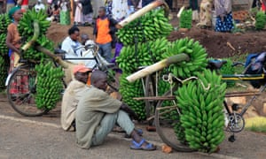
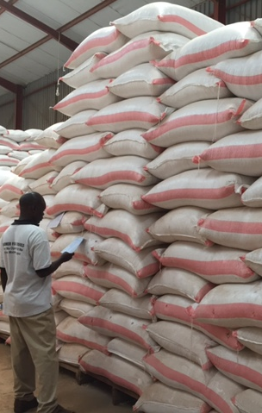
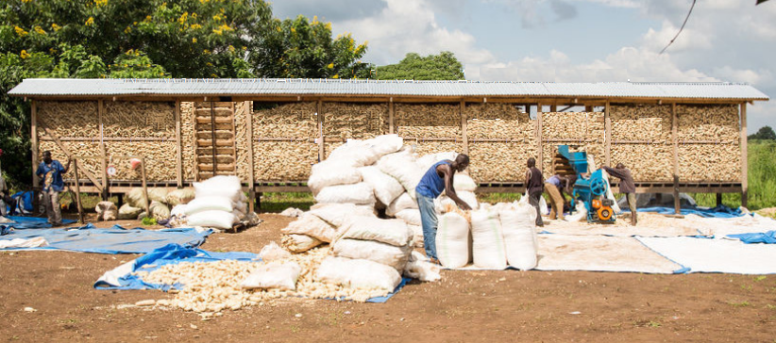
Quality control key in Market linkage

Slide 9
Productive Alliances
Developing capacity of farmers’ organizations to enter into such alliances (business development services; negotiation and accessing investment financing)
Developing models and guidelines for Productive Alliances (PAs)
Piloting PAs and scaling them out
Scaling out PAs

Slide 10
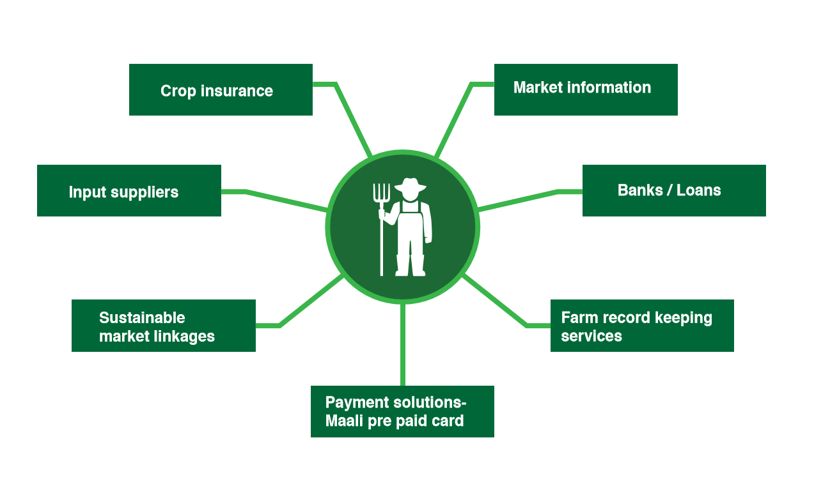
Possible Productive Alliances
Buyers/Off taker(s)
BDS Provider(s)

Slide 11
End

